Slide 1
Master’s Defense
Kyle Coapman
June 10, 2020

Slide 2
Agenda
Introduction and Context
Student Academic Results
Student Character Results
Portfolio Entries
Key Insights

Slide 3
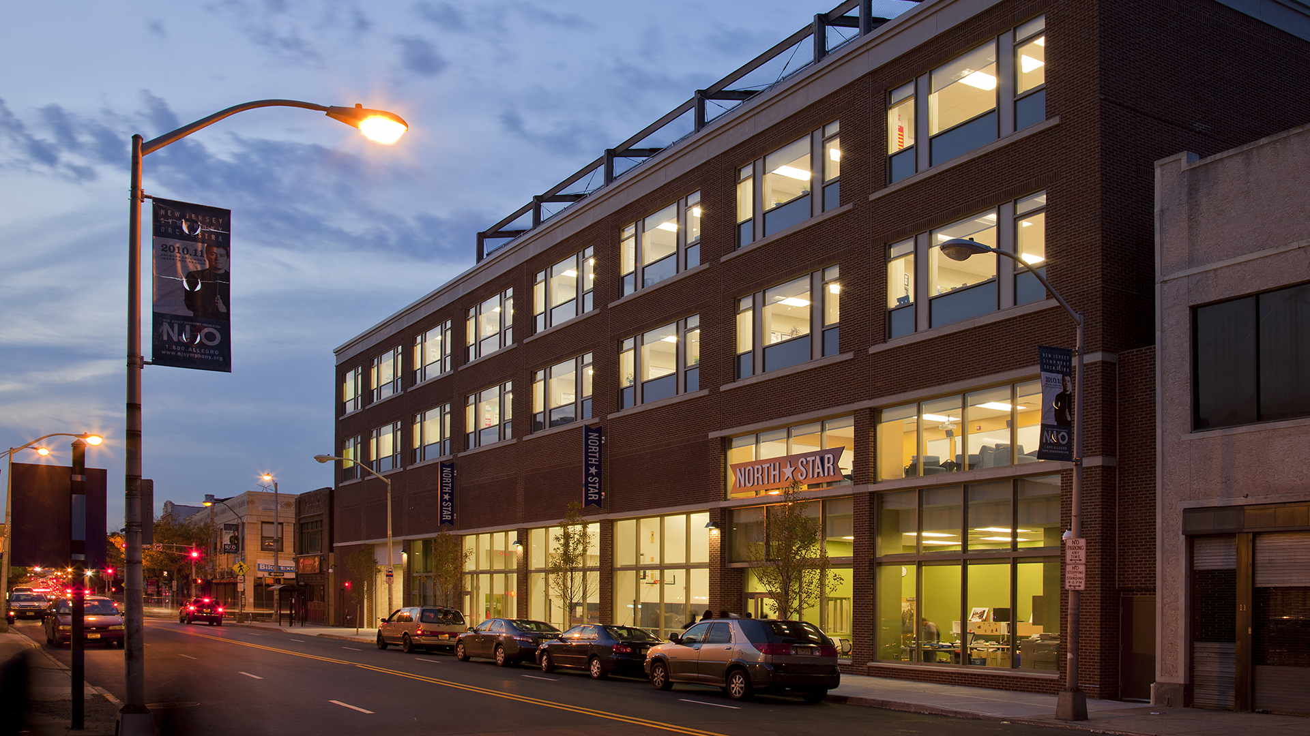
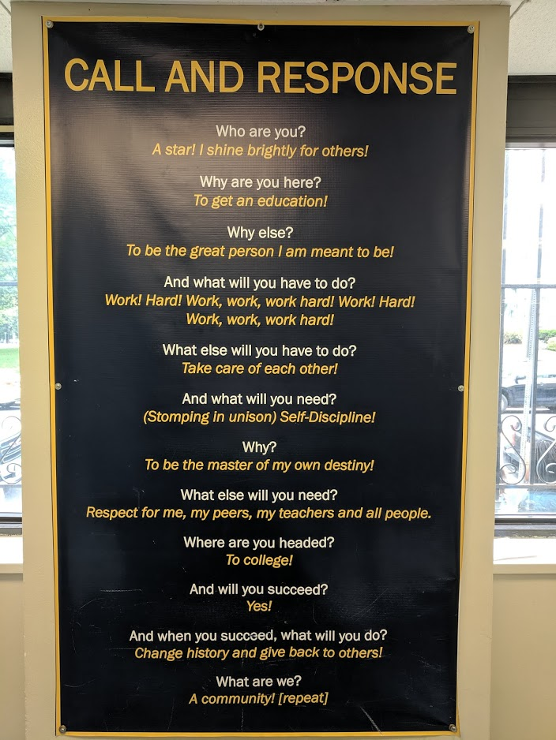
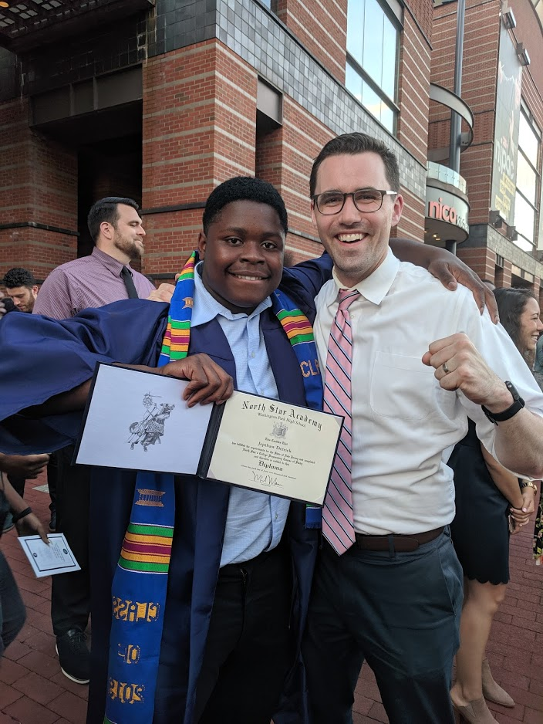
North Star Academy Washington Park HS

Slide 4
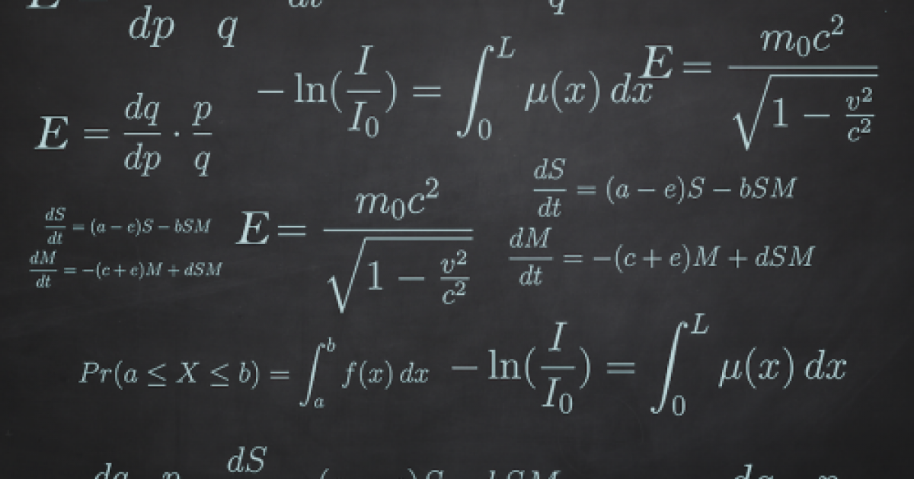
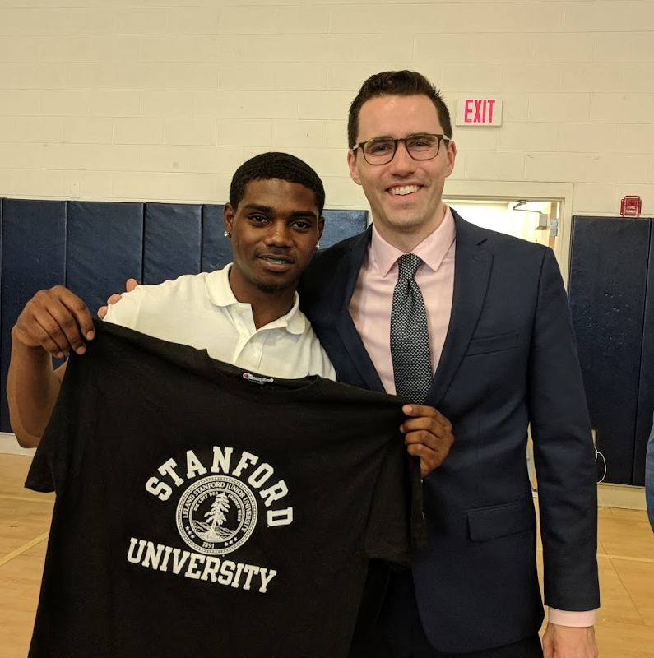

AP Calculus BC

Slide 5
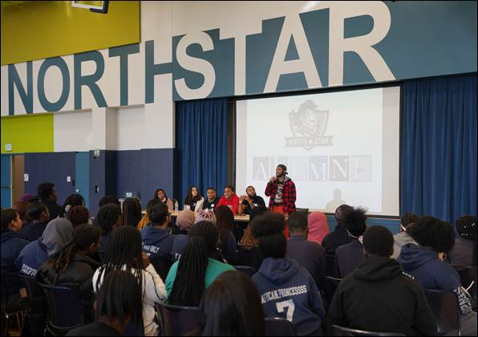
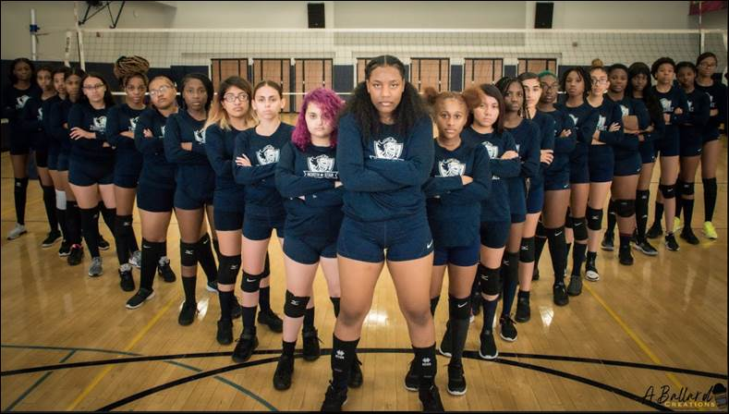
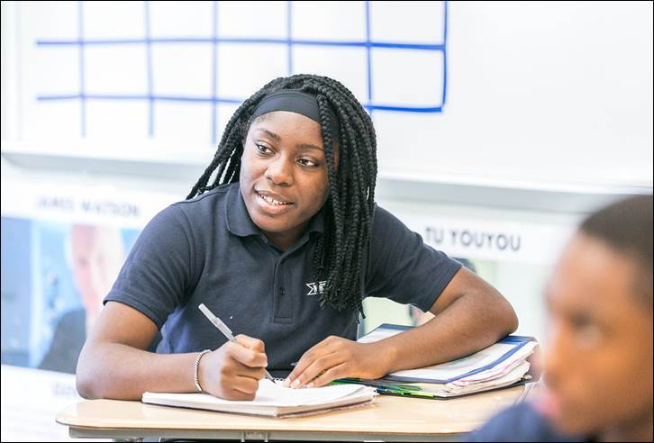
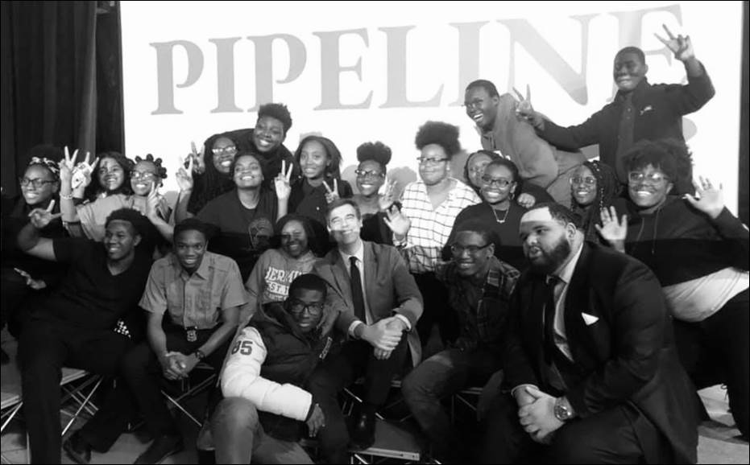
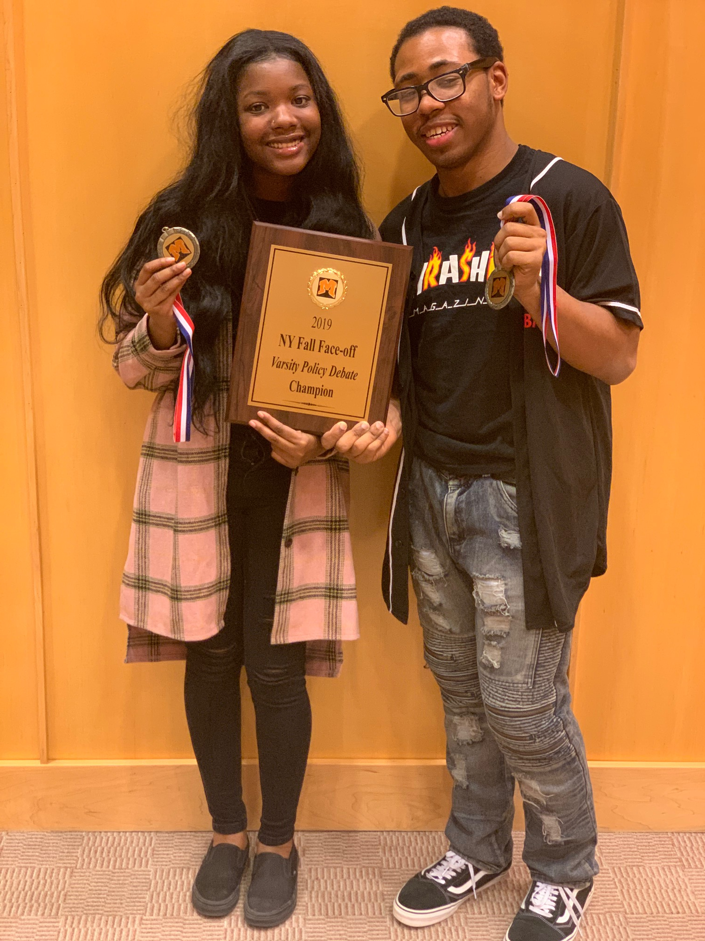
Students

Slide 6
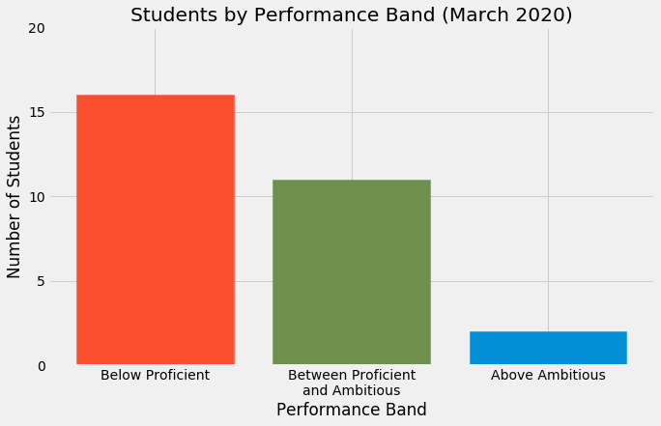
Overall Standards Mastery

Slide 7
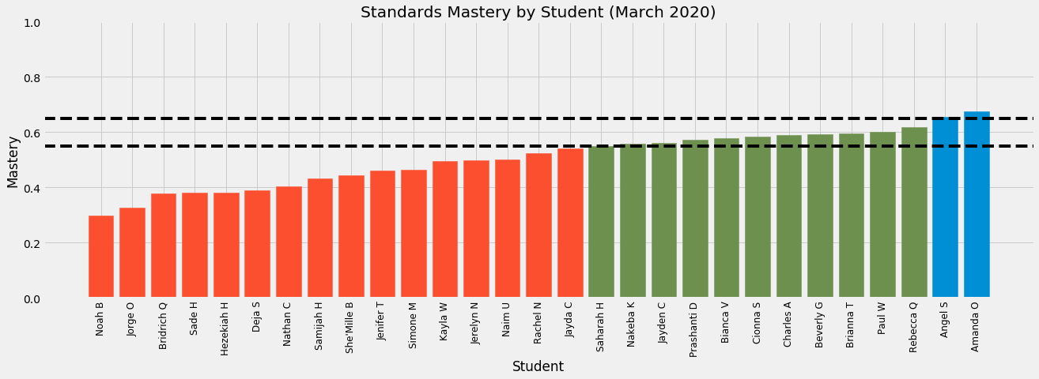
Mastery by Student

Slide 8
Research Question #1
Waiting on data narrative

Slide 9
Research Question #2
Waiting on data narrative

Slide 10
My Perspective on Academic Results
Waiting on data narrative

Slide 11
Overall Character Results
Waiting on data narrative

Slide 12
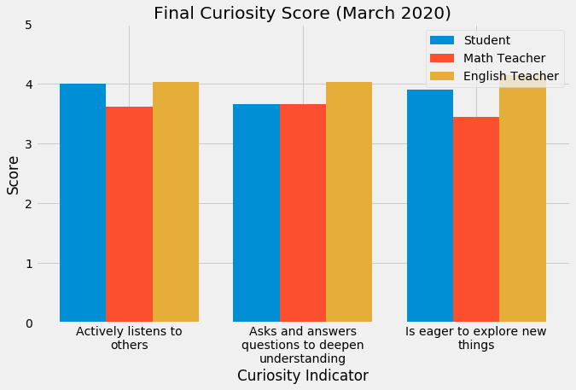
Character Results - Mastery

Slide 13
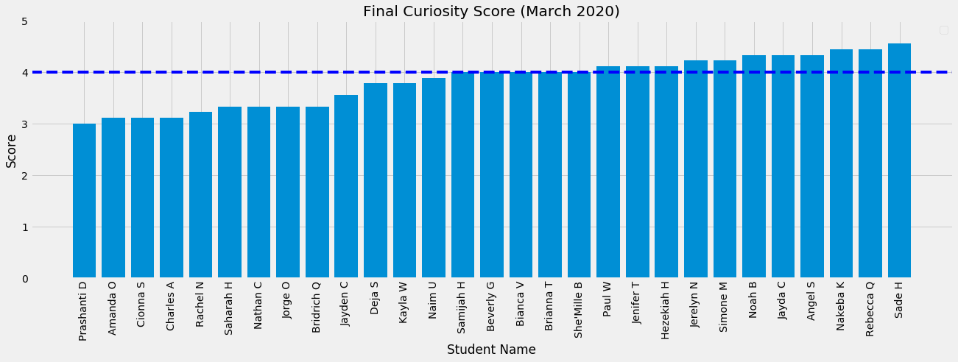
Character Results - Mastery

Slide 14
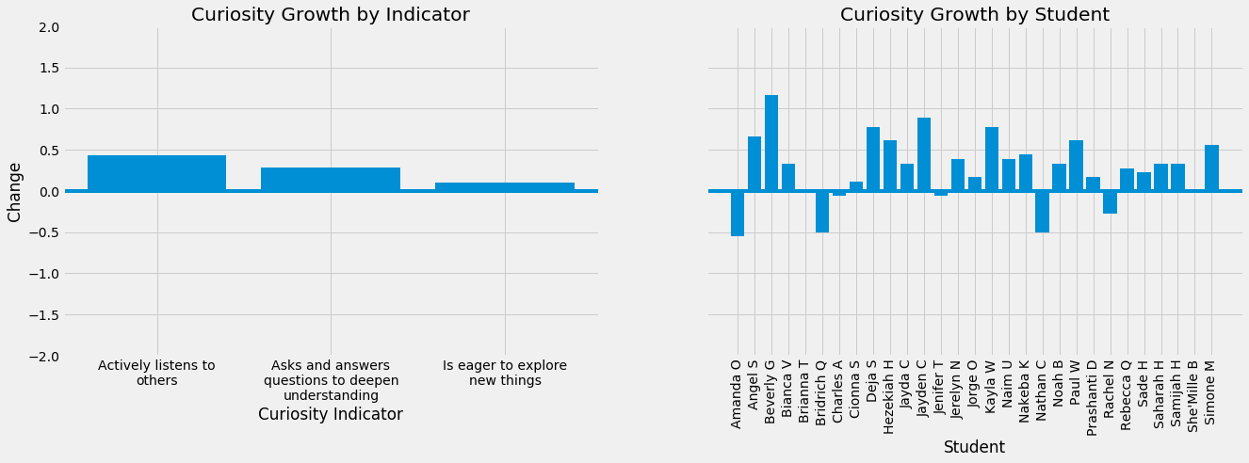
Character Results - Growth

Slide 15
My Perspective on Character Results
Waiting on data narrative

Slide 16
Portfolio Entry #1
Need to do portfolio first

Slide 17
Portfolio Entry #2
Need to do portfolio first

Slide 18
Portfolio Entry #3
Need to do portfolio first

Slide 19
Portfolio Entry #4
Need to do portfolio first

Slide 20
Key Insight #1
Need to think this out in long form first

Slide 21
Key Insight #2
Need to think this out in long form first

Slide 22
Thank you!
Professor Hill
Professor Farnum
Professor Greene
Dean V
Jeffrey Duncan-Andrade
Zaretta Hammond
Doug Lemov
WPHS Math Department
Syrena Burnam
Mike Taubman
Beth Verrilli
Allison Johnson
Alyse Amato
Ashling Coffey
Anushae Syed
Poorvi Goradia
Julia Addeo
Michael Mann
Chris Palermo
Denarius Frazier
Nick Stano
Blake Sukar
Alissa Fong
Melissa Scheve
Allison Post
Cassidy Rosenblum
Mike Woodward
Alex Sylvester
Phil Berkaw
Rachel Gainer
Amanda Page
John Allenbach
Trevor Baisden
Michael and Machael Sherry
Jennifer Brown
Dean and Ross Coapman
Scott and Susan Coapman
Jack and Hope Sherry
Jack and Connie Coapman
Justine Coapman

Slide 23
Questions

